Slide 1
Singapore Solution Center Demo Booking Process
Nov 2015

Slide 2
Singapore Solution Centre – Demos (BU view)
HPE Hyper-Connected Workplace Solutions
HPE 3PAR StorServ & StoreOnce BURA Solutions
HPE Data Center, Network Management & Converged Networking
HDI & eVDI Solution Demo
Citrix XenDesktop and XenApps Solution
HDI/eVDI Integration with HPE BYOD Demo
HPE 3PAR Operating System Suite
HPE 3PAR Thin Technologies Suite
HPE 3PAR Data Optimization Suite
HPE Data Protector on Catalyst
Recovery Manager Central–V
Symantec NetBackup, Commvault Simpana, Veeam with HPE StoreOnce, HPE 3PAR
Intelligent Resilient Framework (IRF)
Data Center Interconnect (EVI/MDC)
Distributed Cloud Networking (DCN)
Virtual Service Router (VSR)
Intelligent Management Center (IMC)
Intelligent Management Center High Availability Management Center (HAC)
Bring Your Own Device (BYOD)
Network Protector SDN Application
Network Visualizer SDN Application
BIMS Demo to Deploy GDVPN

Slide 3
Singapore Solution Centre – Demos (TA view)
Transform to a Hybrid Infrastructure
Enable Workplace Productivity
Empower a Data-Driven Organization
Protect Your Digital Enterprise
HPE 3PAR Operating System Suite
HPE 3PAR Thin Technologies Suite
Intelligent Resilient Framework (IRF)
Data Center Interconnect (EVI/MDC)
Distributed Cloud Networking (DCN)
Virtual Service Router (VSR)
Intelligent Management Center (IMC)
Intelligent Management Center High Availability (IMC HAC) Management Center
BIMS Demo to Deploy GDVPN
Hyper-Connected Workplace - HDI & eVDI Solution Demo
Citrix XenDesktop and XenApps Solution
HDI/eVDI Integration with HPE BYOD Demo
Bring Your Own Device (BYOD)
HPE 3PAR Data Optimization Suite
Network Protector SDN Application
Network Visualizer SDN Application
HPE Data Protector on Catalyst
Recovery Manager Central–V
Symantec NetBackup, Commvault Simpana, Veeam with HPE StoreOnce, HPE 3PAR

Slide 4
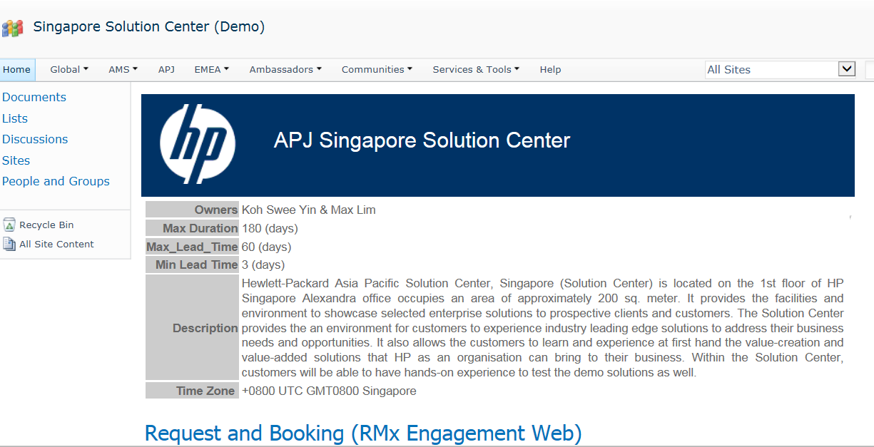
How to book a demo using Engagement Web
http://prime22.sharepoint.hp.com/teams/presales/apj/HQ/SC2010/Singapore%20Solution%20Center%20(Demo)/default.aspx
Note: 1) Chrome browser is not supported.
2) If demo list does not show up after authentication, press F5 to refresh the browser.

Slide 5
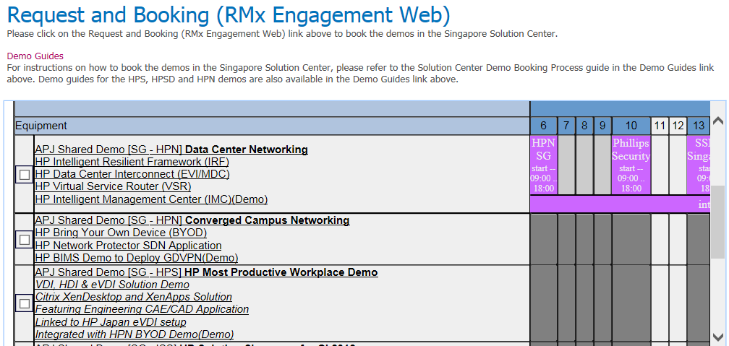
Step 1 – View calendar of demos to determine if desired time slot is available
View calendar of demos to determine if desired time slot is available

Slide 6
Step 2 – Click on Request and Booking link to start booking process
Click on this link “Request and Booking (RMX Engagement Web)” to go to Engagement View

Slide 7
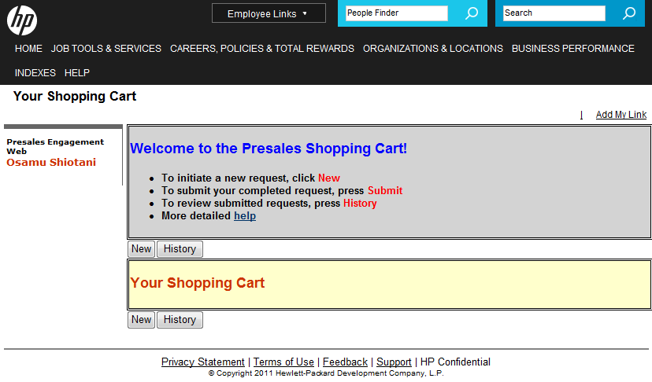
Step 3 – Initiate a new demo request
Click on the New button to initiate Request

Slide 8
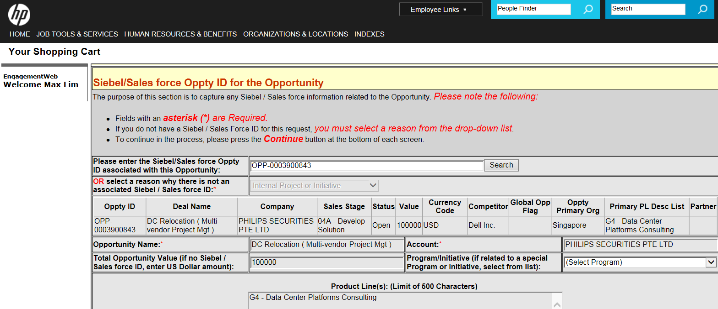
Step 4 – Enter opportunity (SFDC ID)
Enter the SFDC Oppty Id for Demos and click on the search button
For demand generation activities, choose appropriate reason from this list box
Press on Continue to go to next screen

Slide 9
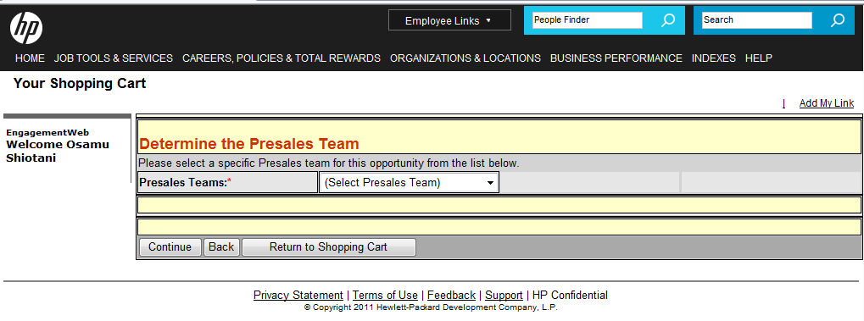
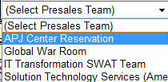
Step 5 – Select the Presales Team “APJ Center Reservation”
Select “APJ Center Reservation”. APJ Center Reservation (WW TechHub) will service your request
Press on Continue button to move to next screen

Slide 10
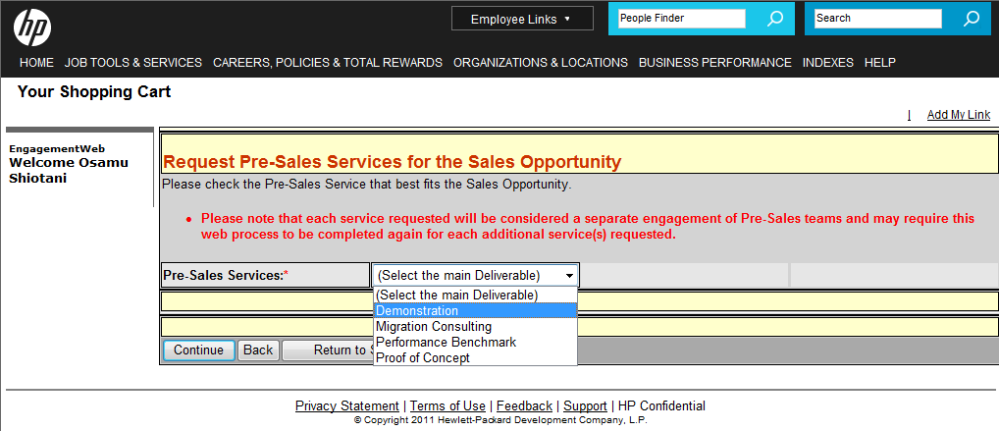
Step 6 – Select Presales Services “Demonstration”
Select the service i.e.
Demonstration
Press on Continue button to move to next screen

Slide 11
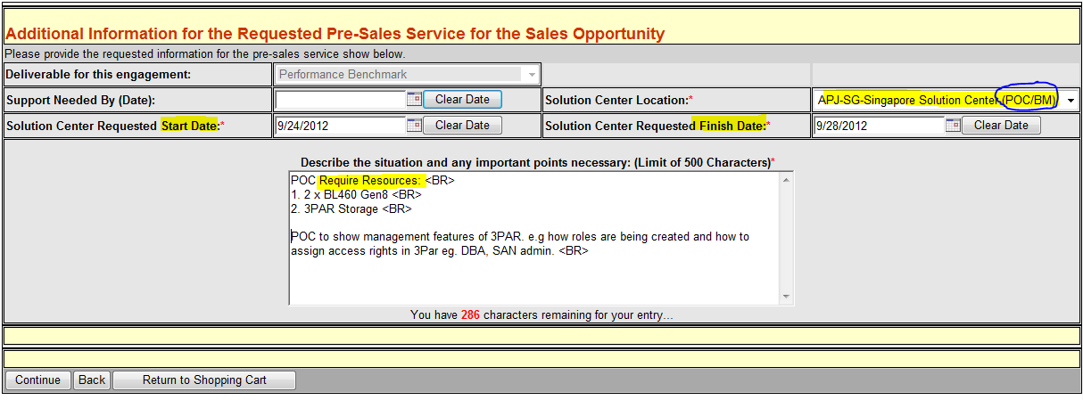
Step 7 – Select Date Period and Solution Center
Select “APJ-Singapore Solution Center (Demo)
Enter the “Request Start Date” and “Request Finish Date”
Enter the Resources. Put “<br>” for the new line of each lines.
Specify start time and end time (local).
Press on Continue button to move to next screen

Slide 12
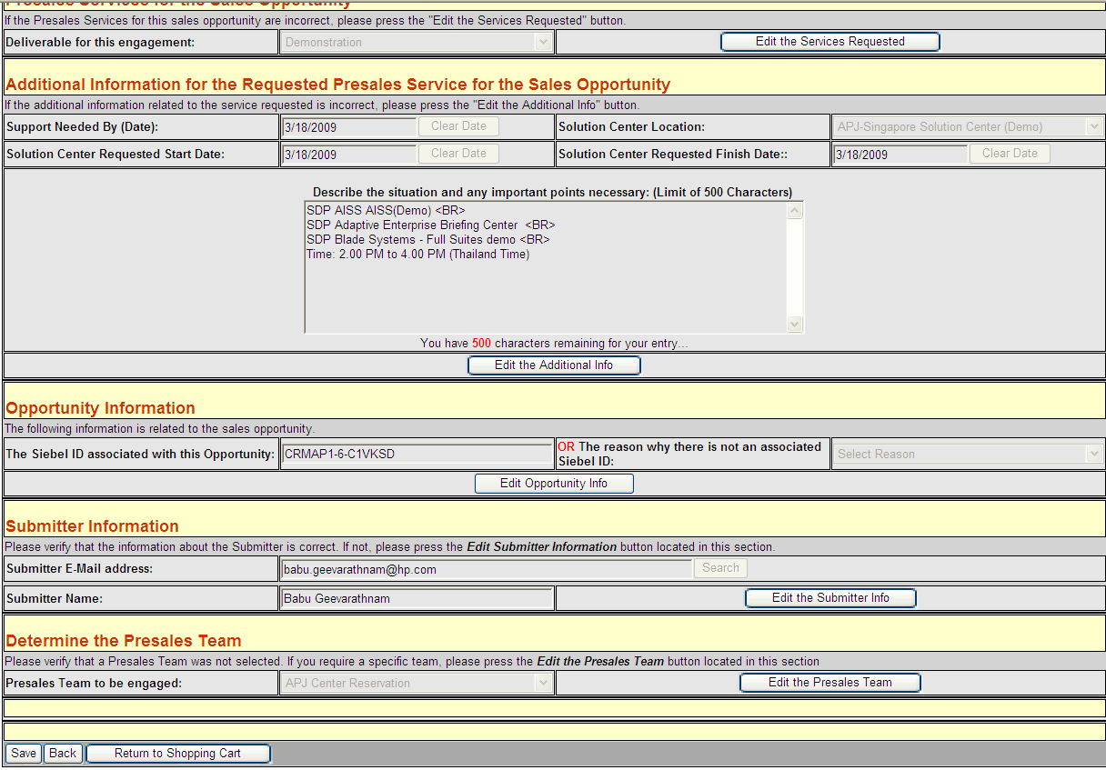
Step 8 – Save your request or Modify the request
Click on the “Edit ***” button (for changing information)
OR
Click on the “Save ” button (for saving the information)

Slide 13
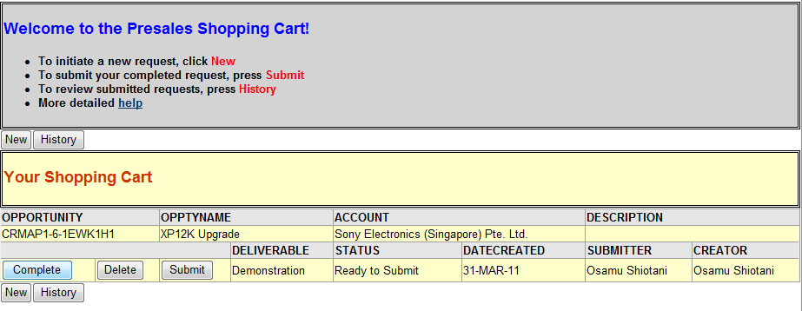
Step 9 – Back to Top Page and Submit Request
Click on the “Submit” button (for sending the request to TechHub)
OR
Click on the “Complete” button (for going back to the previous screen to make changes)
Tips: You can just keep the request form without submit. Engagement Web system save your request form for editing / submitting later on.

Slide 14
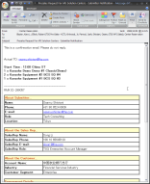
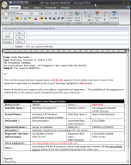
Notifications
After submission the request, in phase by phase on Request Assessment, Confirmation Emails are generated.
Submit Confirmation Email (EWEB Auto Generated)
Requester to know, Engagement Web works correctly to send Requester’s request to APJ Center Reservation within 5 minutes. This does NOT mean Requested Resources have been booked.
Initial Booking Complete Confirmation Email (APJ Center Reservation Generated in 8.0 business hours)
Requester to know Requested resources have been booked and pass to the assessor of requested center. This does NOT mean Request have been accepted.
If the condition haven’t met request or requested resources are already booked by others, rejected email will be issues.
Assessment Complete Confirmation Email (Option Generated by Center in Center defined TAT)
Requested request and resources have been booked and Center will prepare the service to ready by the start date. Requester can be communicate with requester side e.g. Customer, Partner.
Confirmation email
By Center

